Slide 1
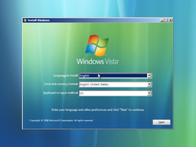
This Photo by Unknown Author is licensed under CC BY-SA

Slide 2

This Photo by Unknown Author is licensed under CC BY-SA

Slide 3
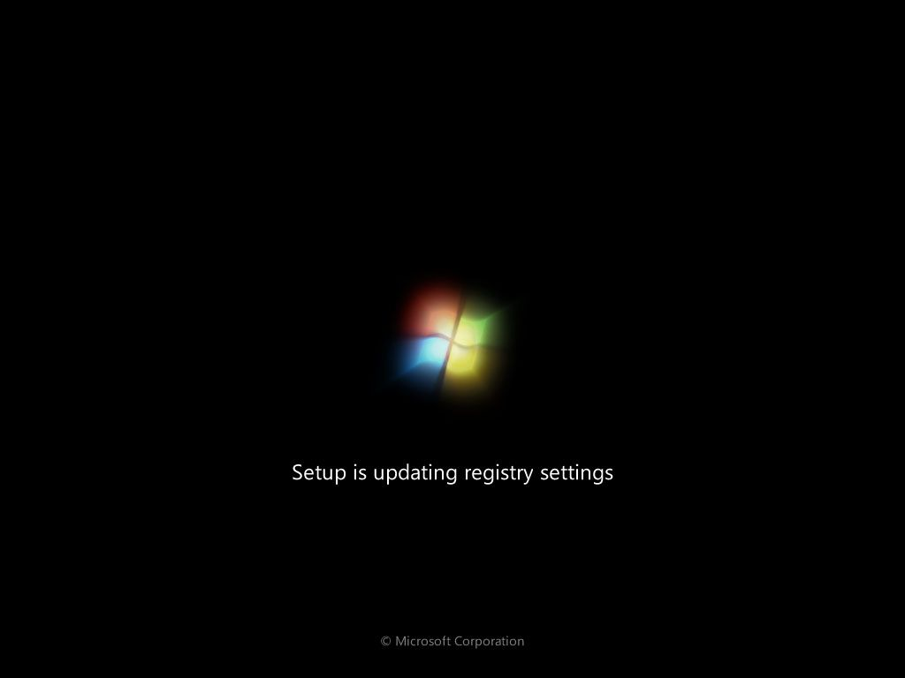

This Photo by Unknown Author is licensed under CC BY-NC

Slide 4
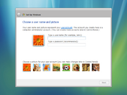
This Photo by Unknown Author is licensed under CC BY-SA

Slide 5
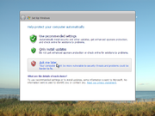
This Photo by Unknown Author is licensed under CC BY-SA

Slide 6
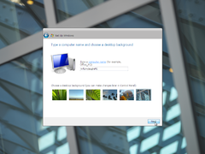
This Photo by Unknown Author is licensed under CC BY-SA

Slide 7
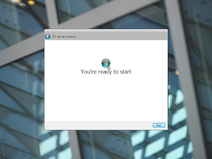
This Photo by Unknown Author is licensed under CC BY-SA

Slide 8
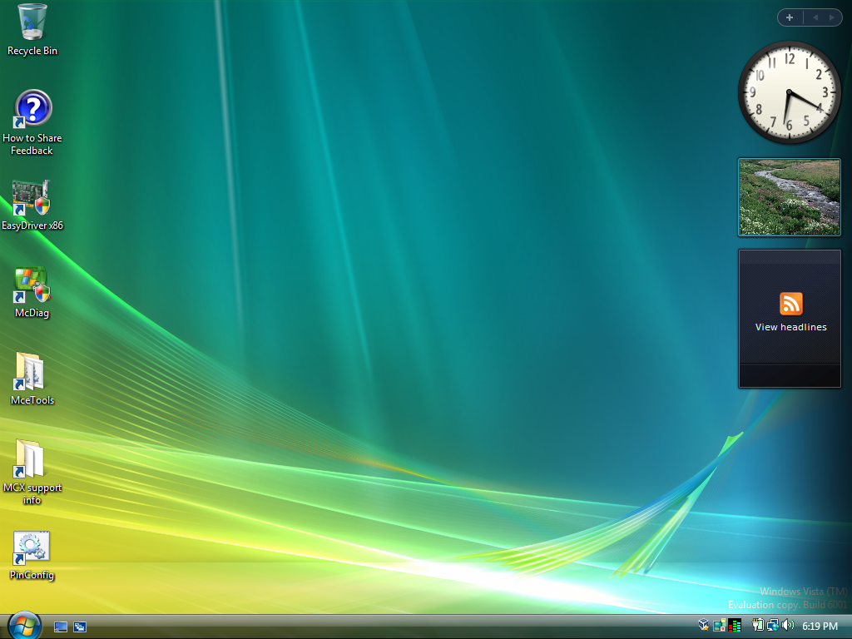
;
This Photo by Unknown Author is licensed under CC BY-SA

Slide 9


Slide 10


Slide 11




Slide 12
Hes sus

Slide 13
Hes sus

Slide 14
You won!

Slide 16
;
This Photo by Unknown Author is licensed under CC BY-SA

Slide 17
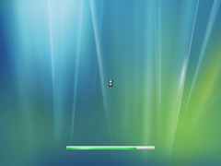
Windows is shuting down
This Photo by Unknown Author is licensed under CC BY-SA

